Slide 1
Making relief in modeling clay
Assignment 1

Slide 2
Introduction
Relief is a sculptural technique where the sculpted elements remain attached to a solid background of the same material. The term relief is from the Latin verb relevo, to raise. To create a sculpture in relief is to give the impression that the sculpted material has been raised above the background plane.

Slide 3
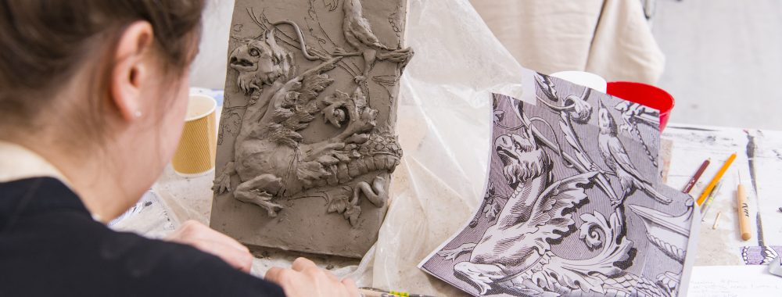

Slide 4
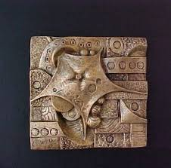

Slide 5
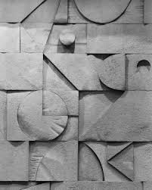

Slide 6
